Slide 1


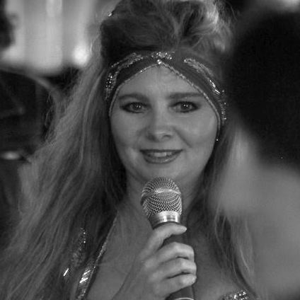
#bodyforbrains Your Body, Your Magnificence, Your Brain! Your Hidden Genius Super Power is your Magical Unicorn Your Body does not lie!
Charlotte D Blignaut

Slide 2
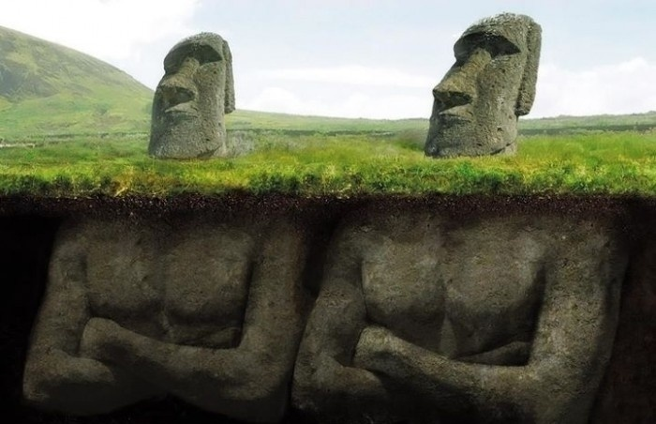


#Body4Brains
Your Body Does not Lie

Slide 3
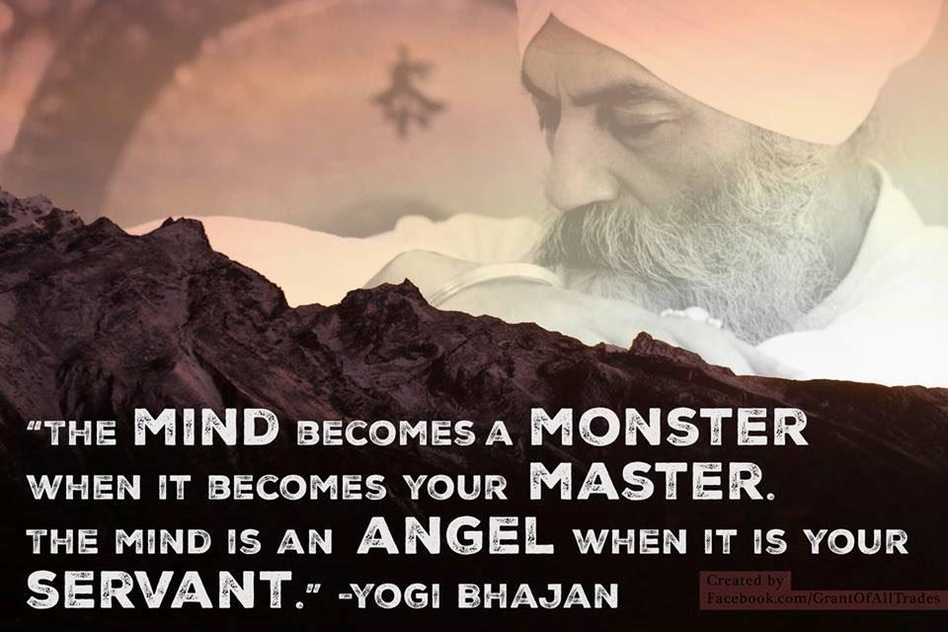

Slide 4
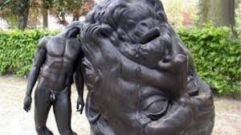
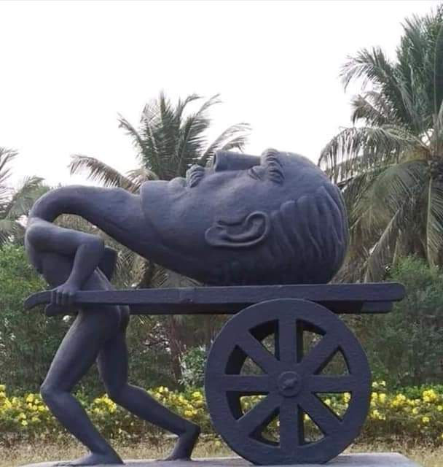

Slide 5
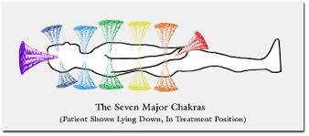
Energy Centres
(also known as Chakras)
Your Warrior Shields of Info & Protection
Breathe into each, with Intentional Mindfulness

Slide 6
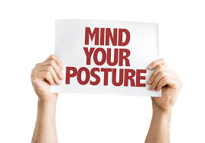
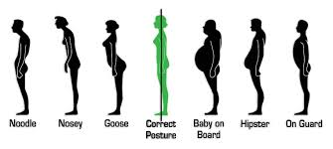

Slide 7

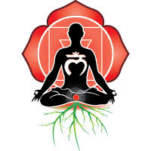
Root

Slide 8

Root

Slide 9
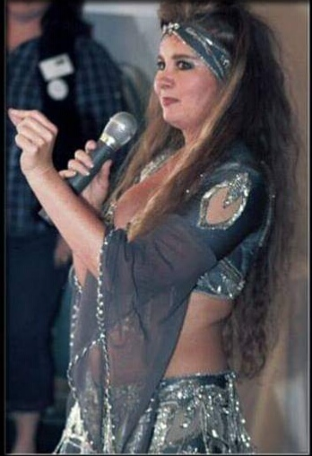
Sacral/Navel

Slide 10

Sacral/Navel

Slide 11
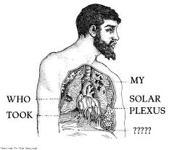
Solar Plexus

Slide 12

Solar Plexus

Slide 13

Your Heart
As the Magical Unicorn Voice
of Your Body

Slide 14
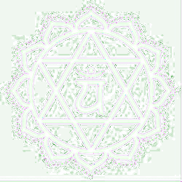
Heart

Slide 15

Throat

Slide 16

Throat

Slide 17
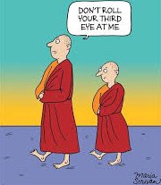
3rd Eye

Slide 18

3rd Eye

Slide 19
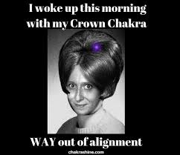
Crown

Slide 20

Crown

Slide 21
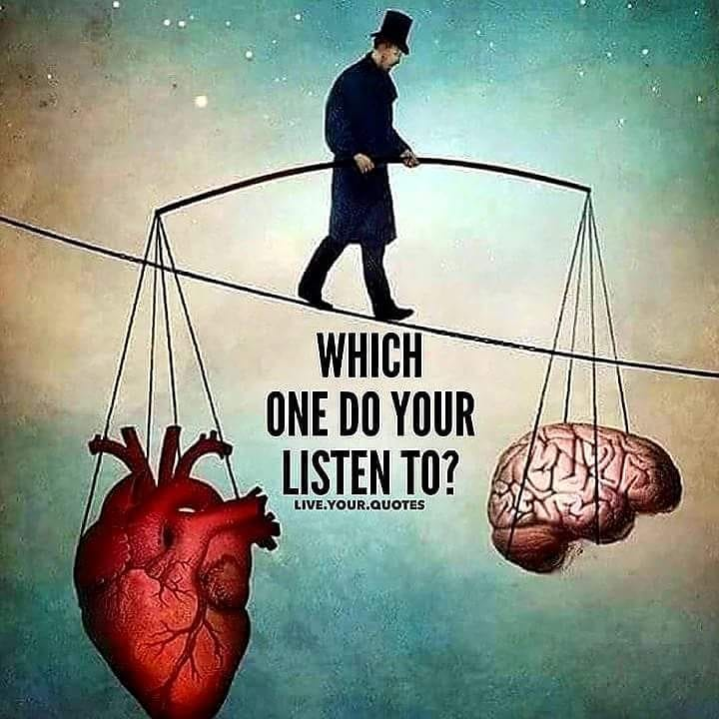
#body4brains @body4brains #inspire2transform @inspire2transform
#YourHiddenGeniusSuperPower
is your Magical Unicorn, Your Body does not lie.

Slide 22

Imagine laser fast Mindset shifts as the Ultimate in Leadership, turning People to more Profits & ALSO Growing Team Productivity, Building Collaboration, Individual Self Confidence & Disrupting Innovation?
www.charlottedblignaut.co.za
#body4brains @body4brains #inspire2transform @inspire2transform
#YourHiddenGeniusSuperPower
is your Magical Unicorn, Your Body does not lie

Slide 23


